Slide 1
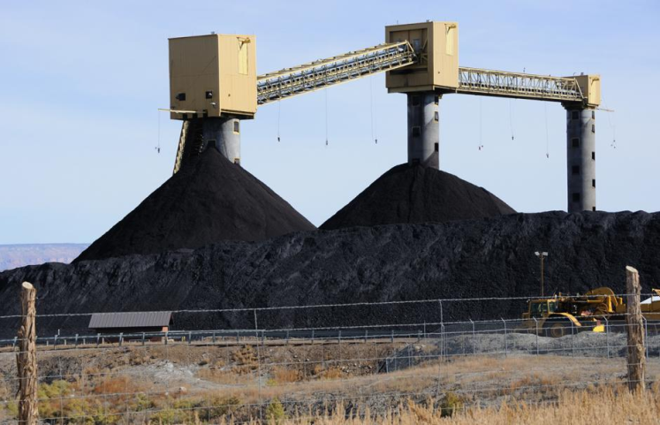
AFD presentation to Climate Action in Financial Institutions Initiative Transition risks in practice

Slide 2
Working on climate financial risks : Why ?

Slide 3
Working on climate financial risks : Why ?
Regulatory pressure

Slide 4
Working on climate financial risks : Why ?
Regulatory pressure
Sound financial management / financial stability

Slide 5
Working on climate financial risks : Why ?
Regulatory pressure
Sound financial management / financial stability
Contributing to climate change mitigation and adaptation

Slide 6
AFD roadmap for Climate related Financial Risks (CFR)
1. Integrating CFR in AFD operations and strategy
3. Supporting the development and use of CFR tools and methods by AFD’s partners (primarily FI and regulators)
2. Mobilising CFR for policy dialogue
4. Contributing to international debates and norm-settting around CFR

Slide 7
Different approaches to CFR assessment and management
Portfolio analyses vs tools for analysing new investments/loans
Bottom-up vs top-down
Micro vs macro
Read use vs tailored/ad-hoc
Internal vs external

Slide 8
The South Africa transition risk pilot case study
Motivations :
To contribute to the South African low carbon transition policy debate
To propose a reference study on methodology and approach to transition risks
To work with our South African partners on the integrating of transition risks in strategies and operations
Technical partnership with Climate Policy Initiative
Deep engagement with DBSA

Slide 9
The South Africa transition risk pilot case study
South Africa-related follow-ups to the study :
“Thinking together” South African DFI’s : DBSA, IDC
Climate Risks and Financial Stability
“Steering towards a green economy”
3. Stimulus and recovery package / COVID-19

Slide 10
The South Africa transition risk pilot case study
Non South Africa-related follow-ups to the study :
Future AFD-CPI collaborations and studies in other countries
Extension and improving the methodology : other industrial sectors, land-use, stronger focus on just transition, links to macro-models
Possible application to physical risks
Wider range of partners and greater outreach

